Slide 1
Reenal Boddul
Consultant at Dewberry

Slide 2
Agenda
Data Analysis
Available Models
My Models Result

Slide 3
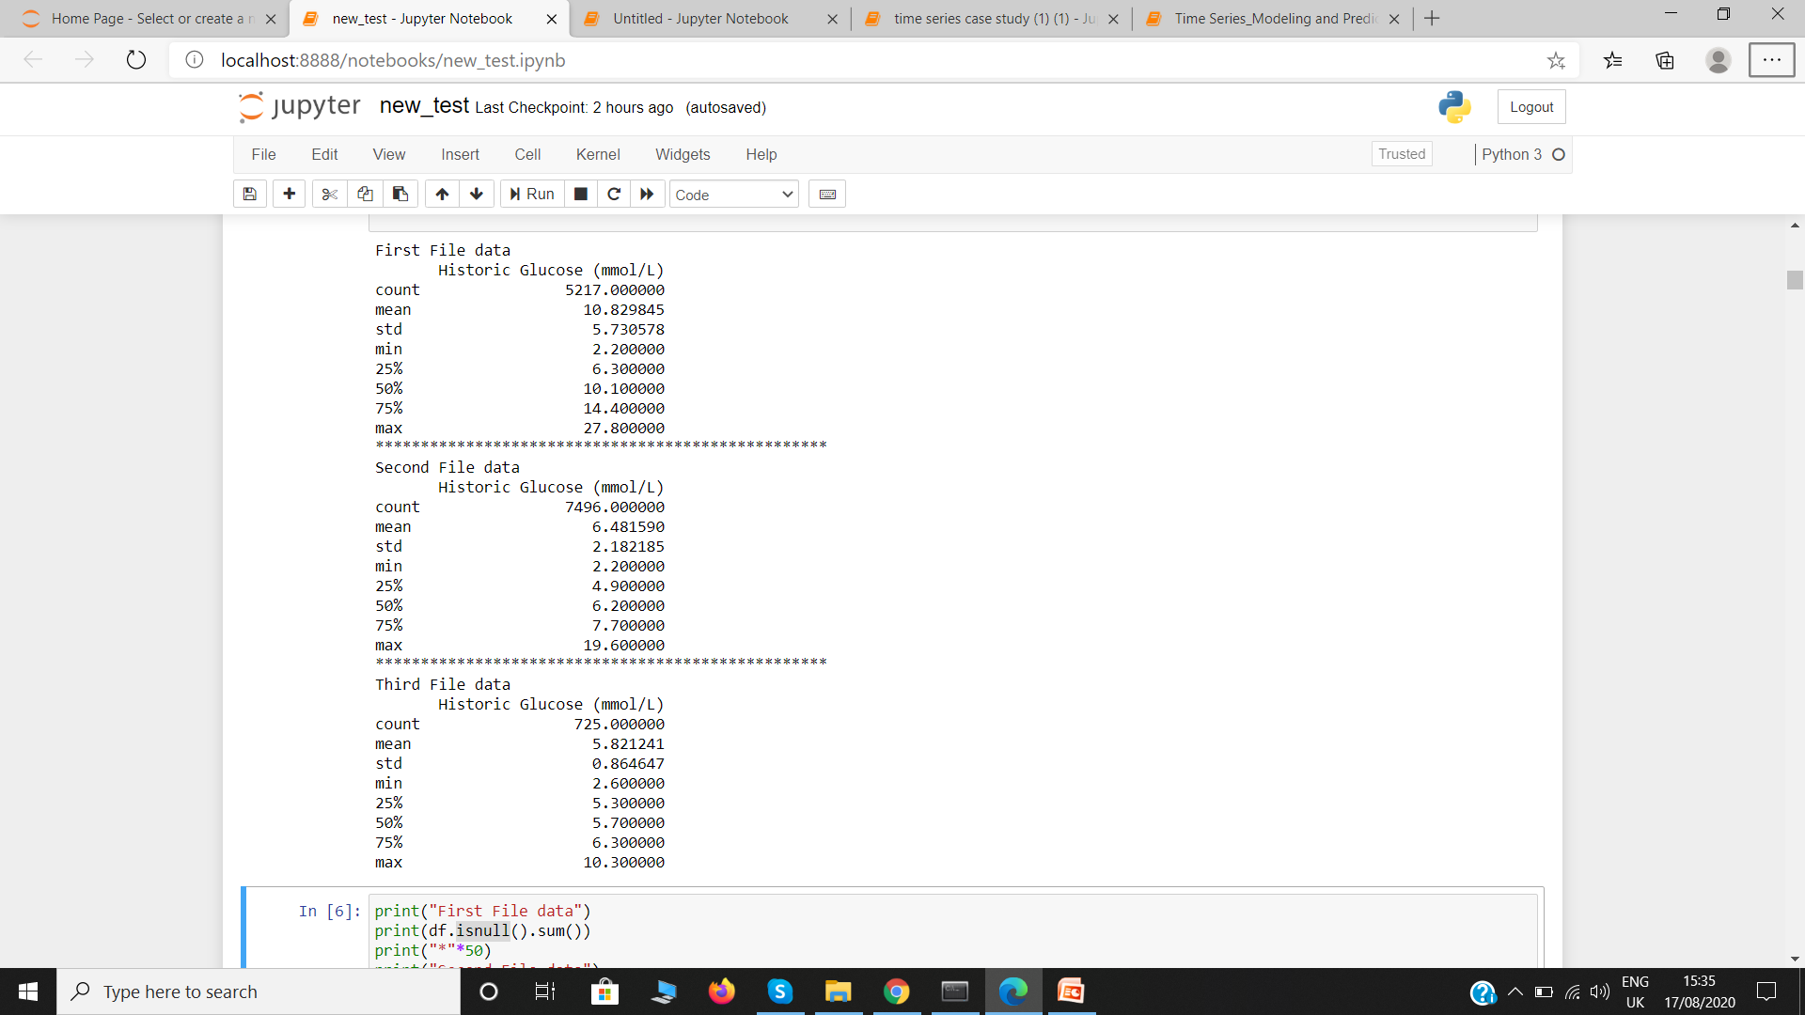
Data Analysis
Checking Basic Stats
Mean ,Std , Min , Max ,Null

Slide 4
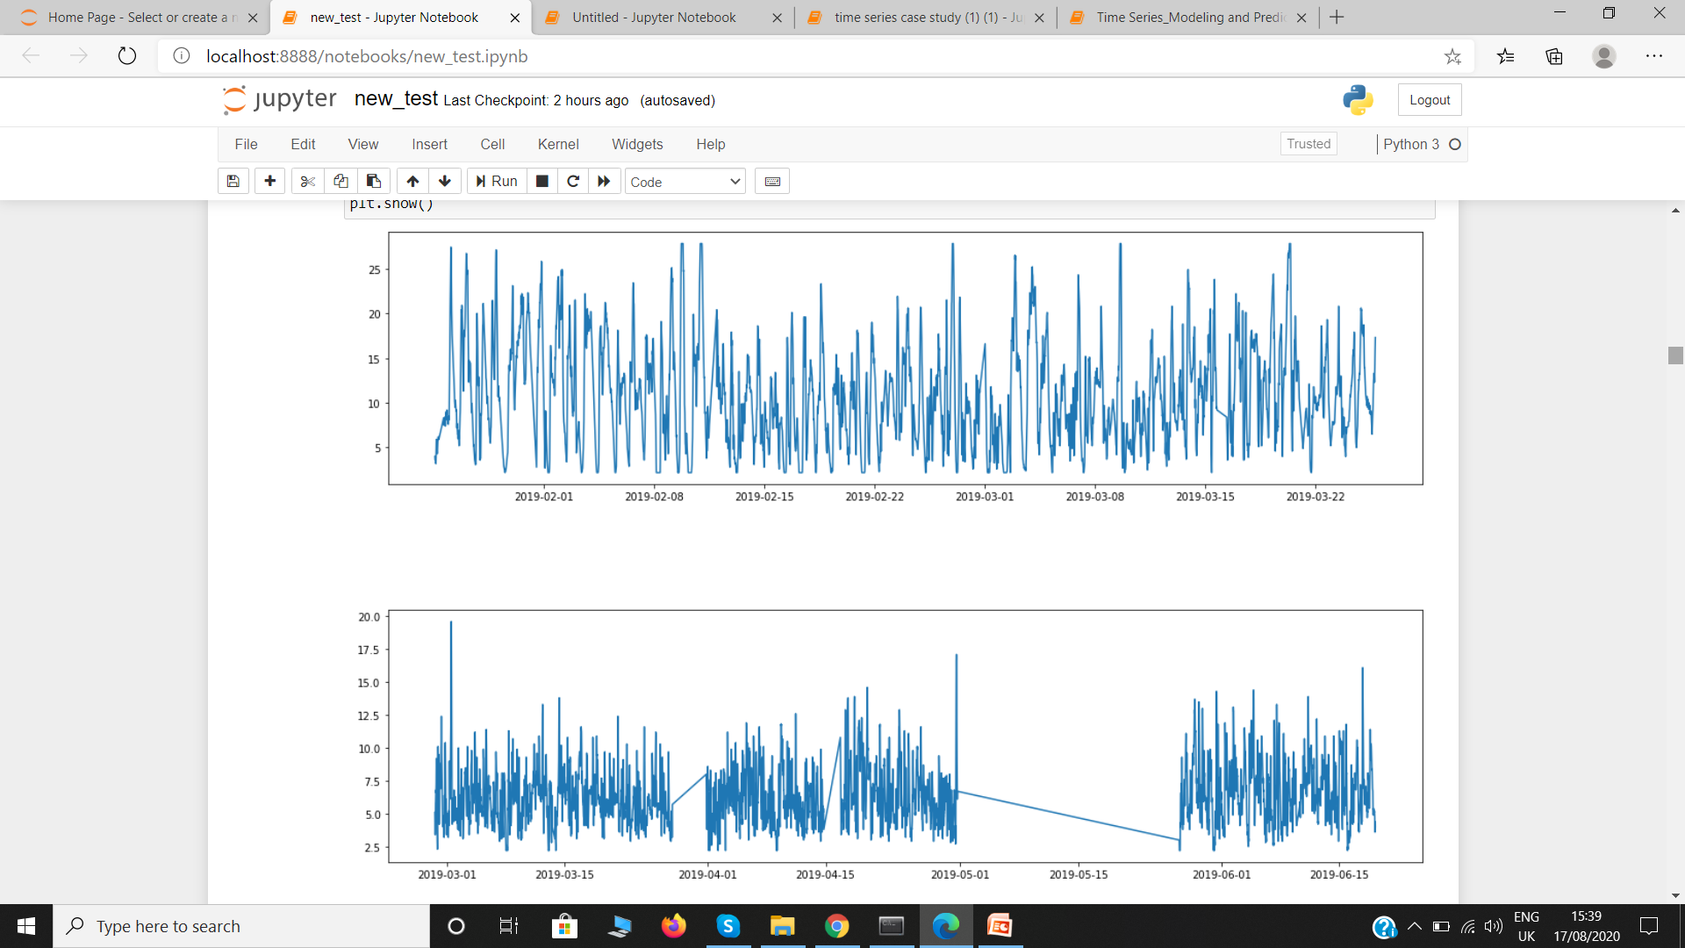
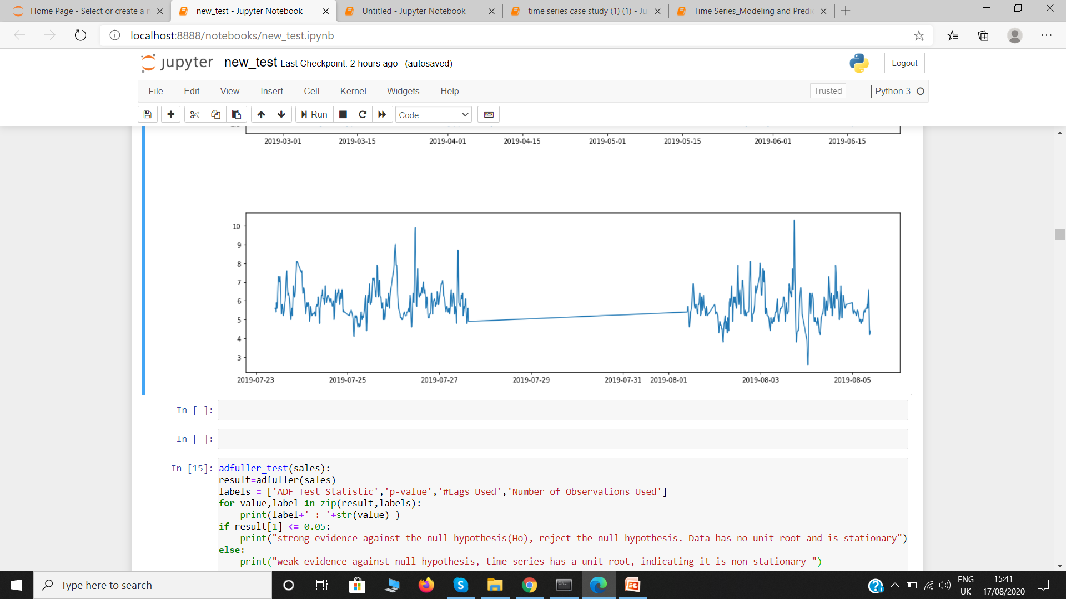
Data Analysis continuation
Plot of Glucose Over Time

Slide 5
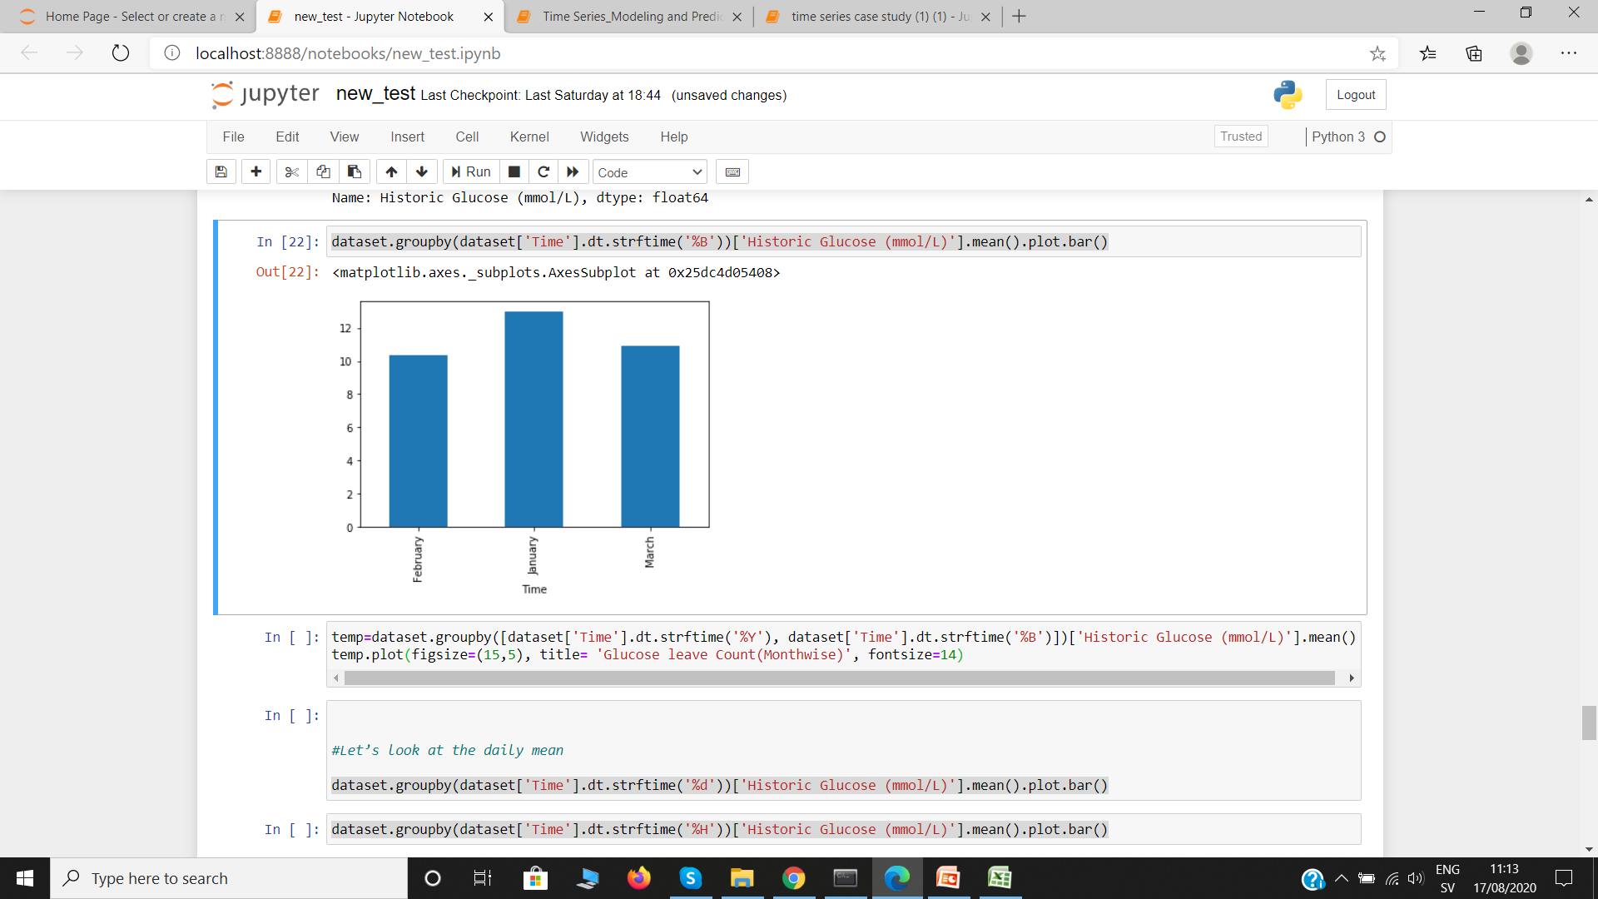
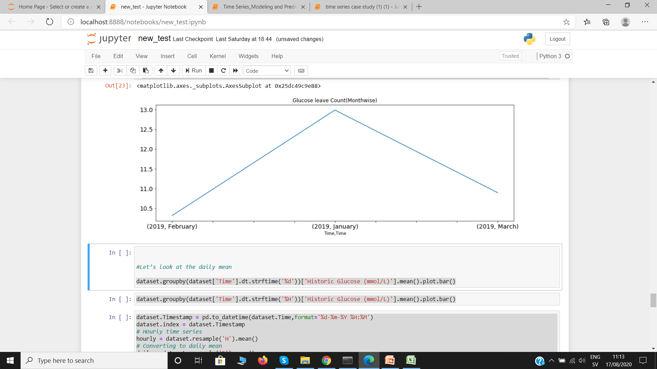
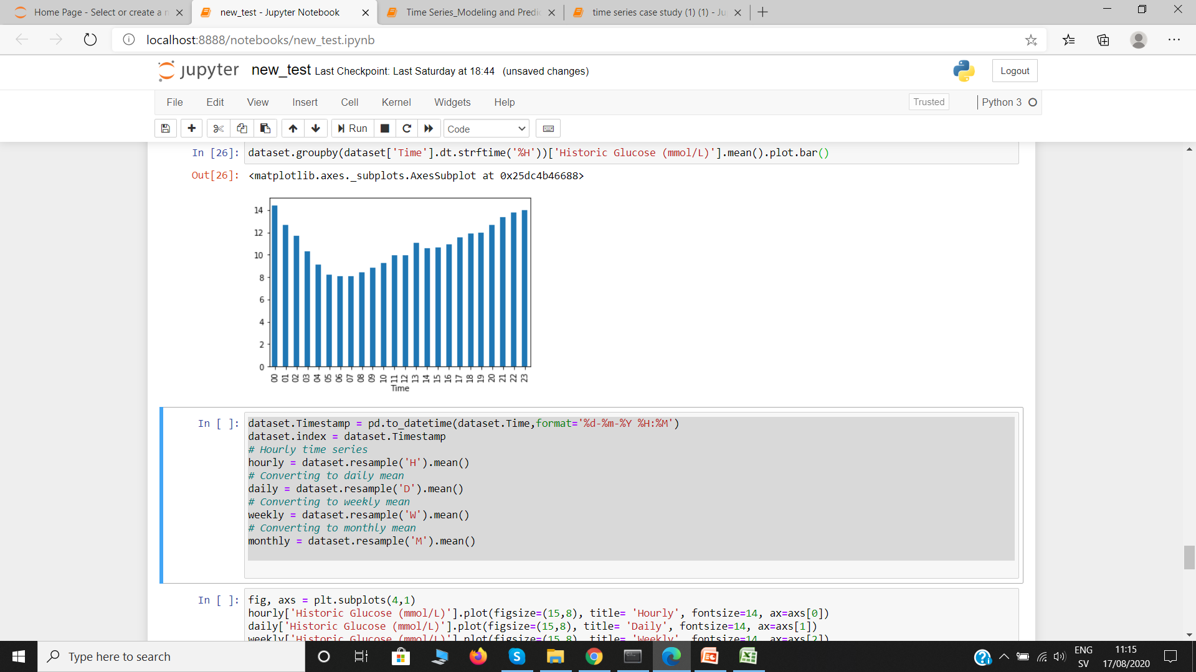
Data Analysis For File 1
Mean Glucose Level Per Month
Glucose Level Month Wise
Glucose Level Per Hr

Slide 6
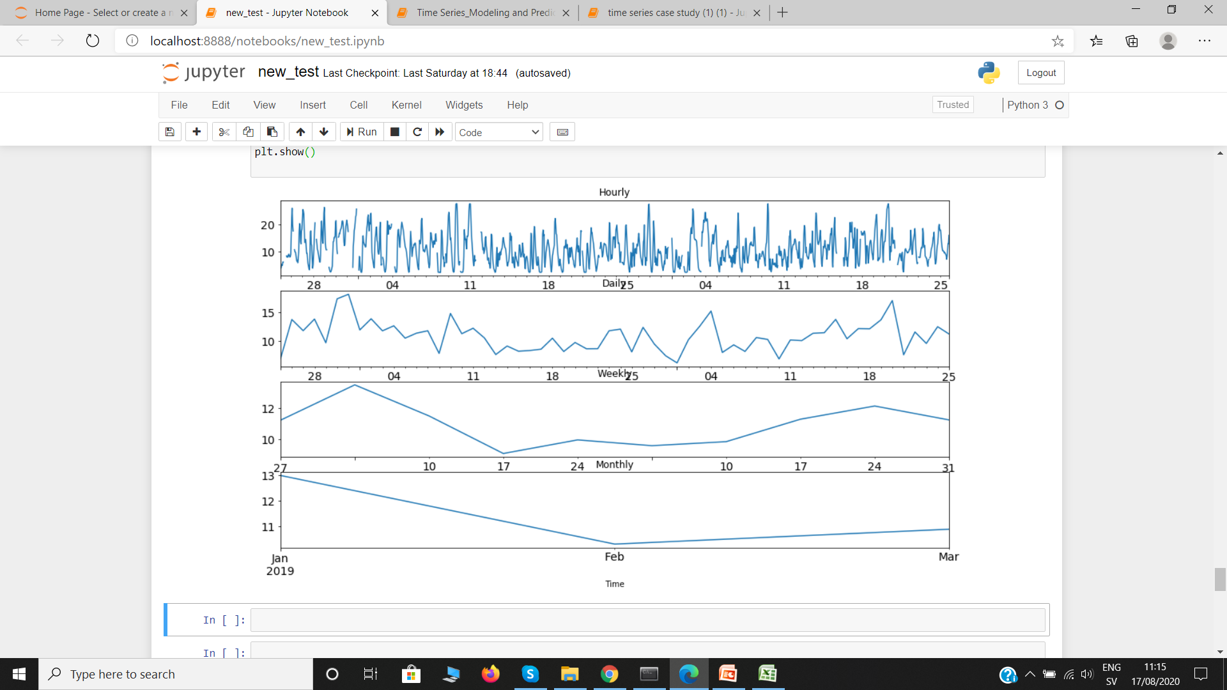
File 1
Glucose Level, Hourly, Daily, Weekly, Monthly

Slide 7
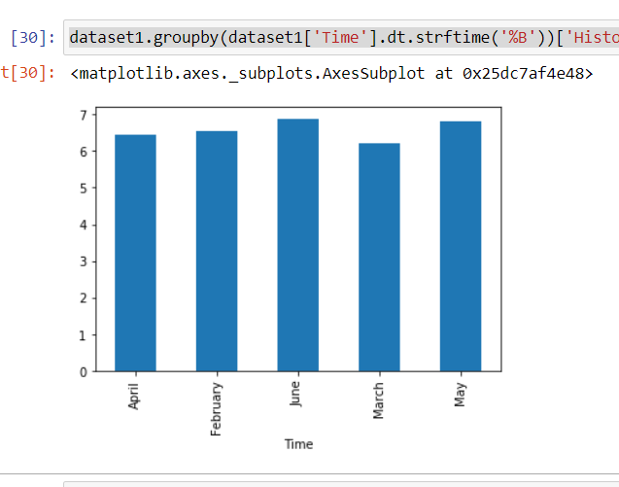
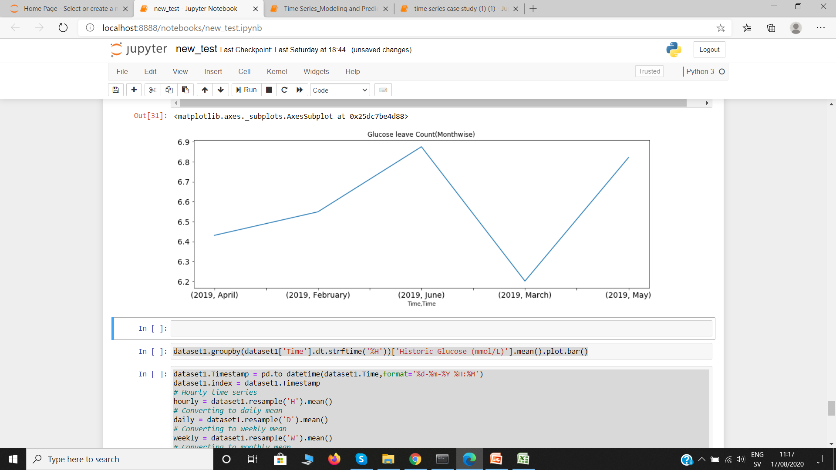
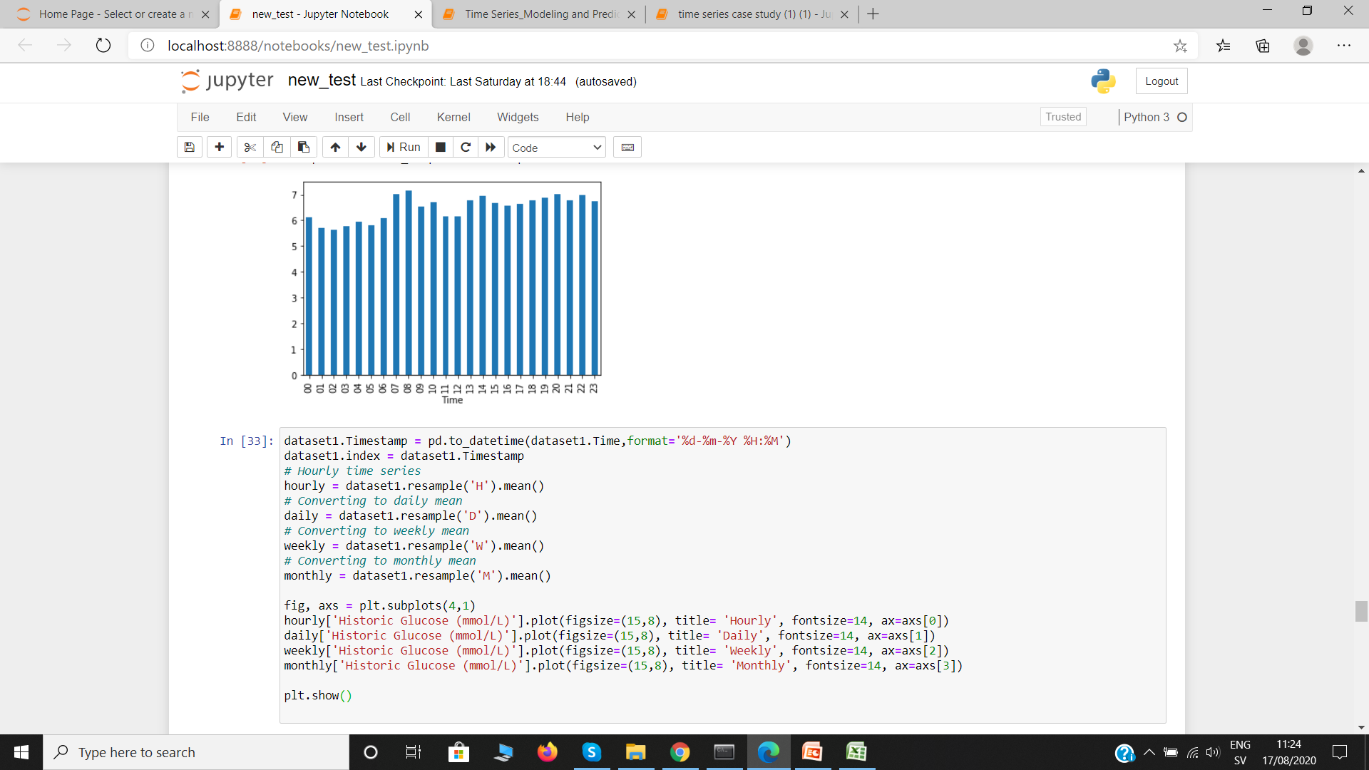
Data Analysis For File 2
Mean Glucose Level Per Month
Glucose Level Month Wise
Glucose Level Per Hr

Slide 8
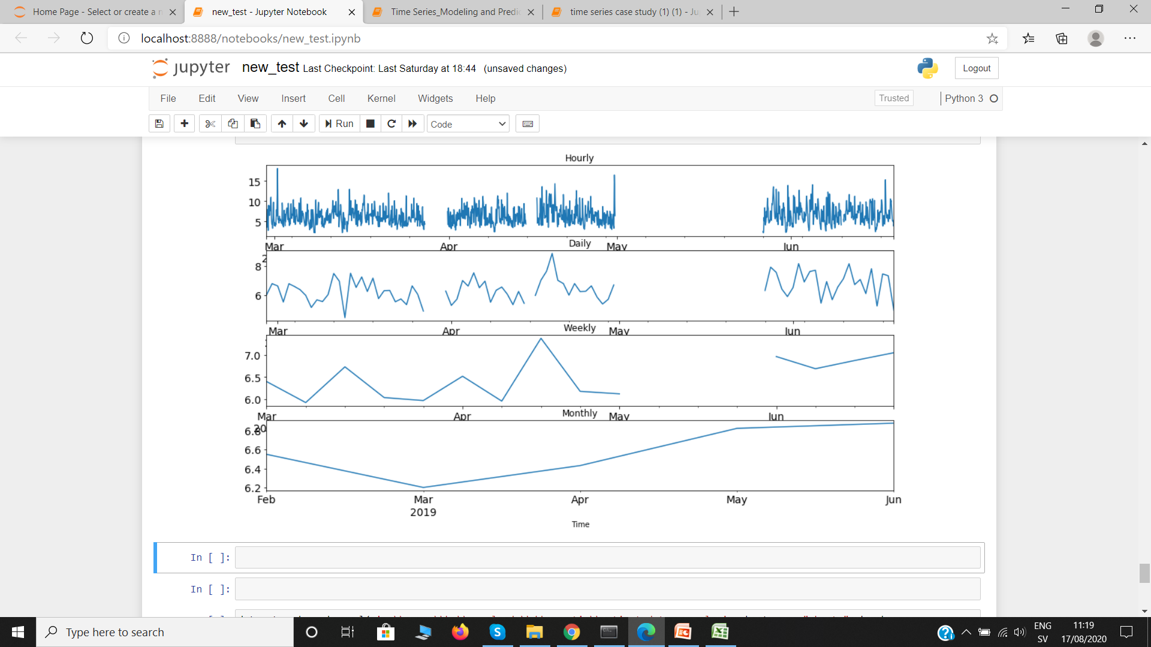
File 2
Glucose Level, Hourly, Daily, Weekly, Monthly

Slide 9
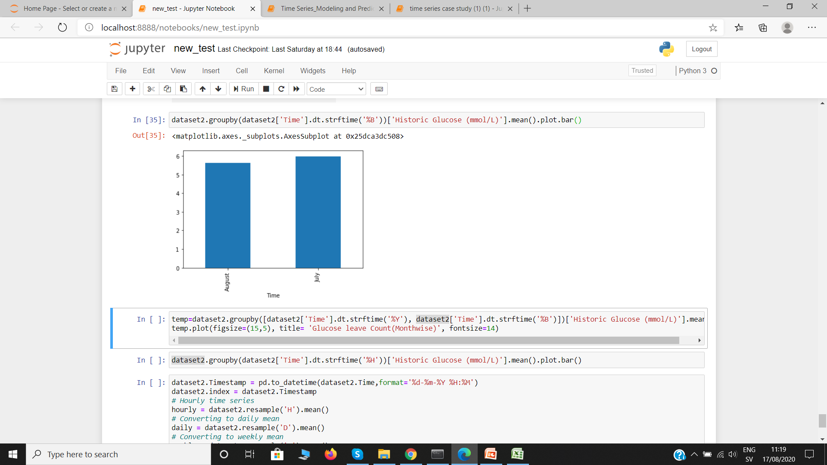
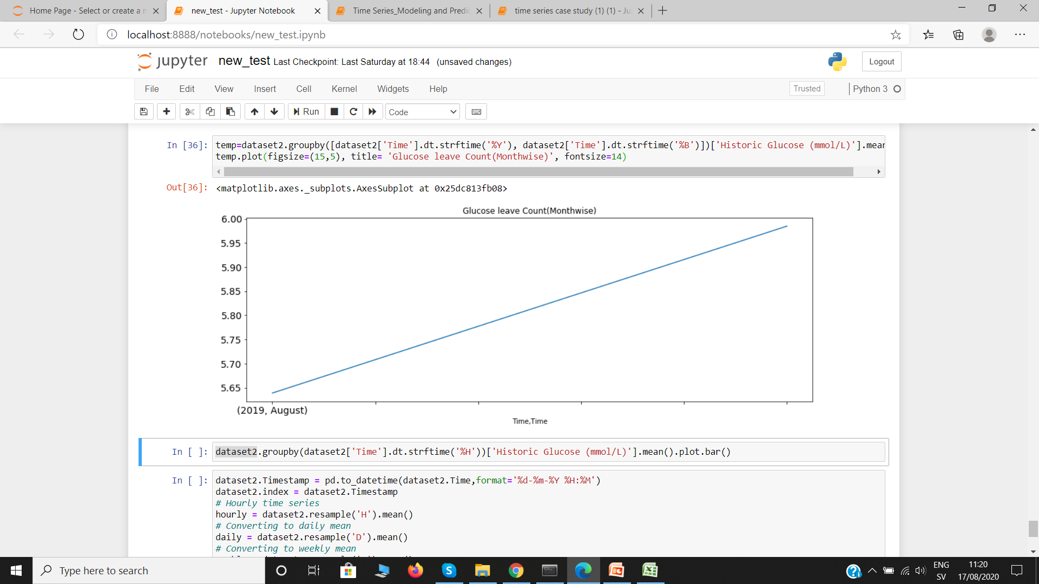
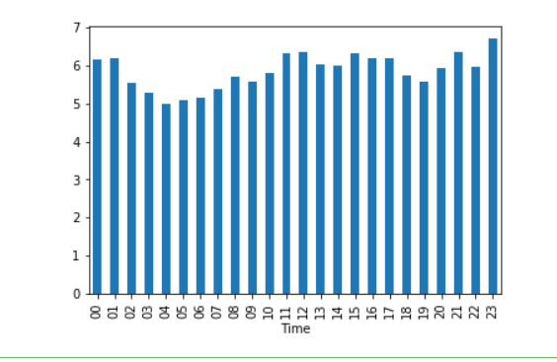
Data Analysis for File 3
Mean Glucose Level Per Month
Glucose Level Month Wise
Glucose Level Per Hr

Slide 10
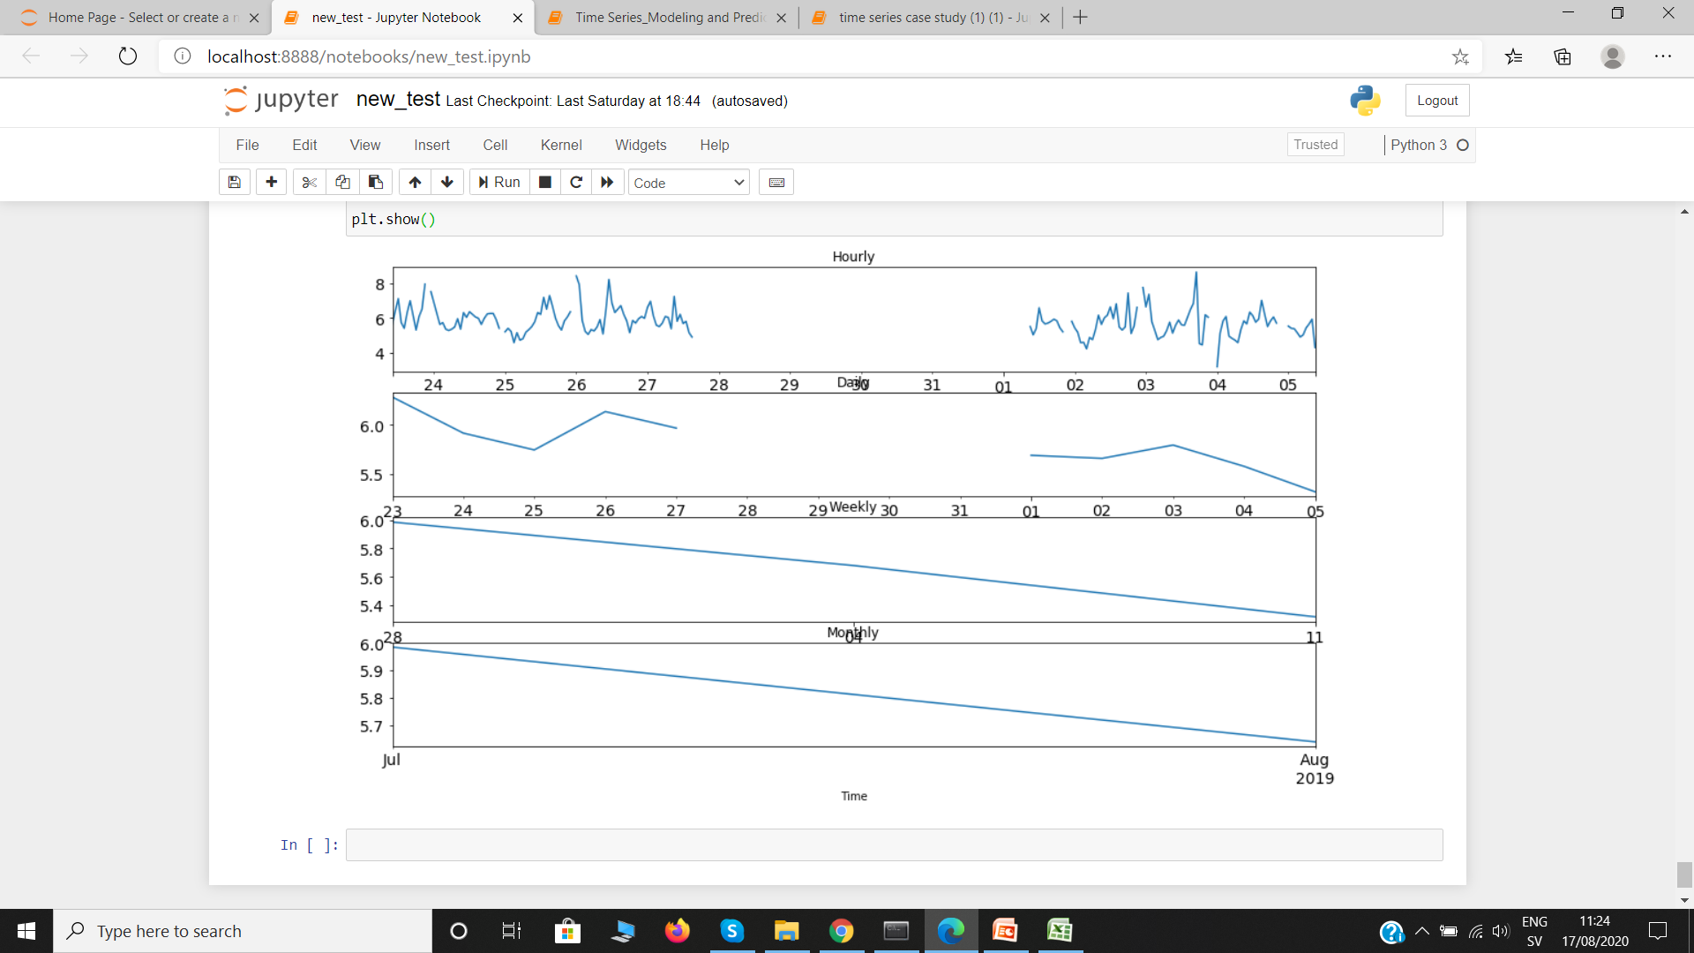
File 3
Glucose Level, Hourly, Daily, Weekly, Monthly

Slide 11
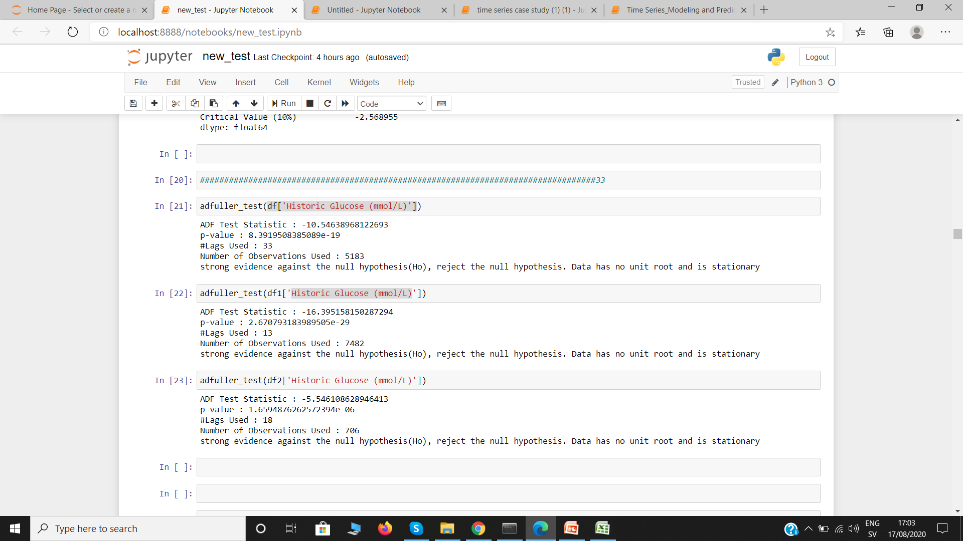
Preliminary Data Analysis
adfuller_test
For Stationary Checking Of Data

Slide 12
Available Models
ARIMA
LSTM
ARCH
Xgboost (XGBRegressor)

Slide 13
My Models Result
I have tried two model:
A) XGBRegressor
B) ARIMA
Results are in following slides

Slide 14
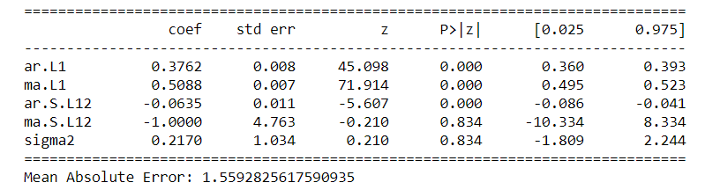
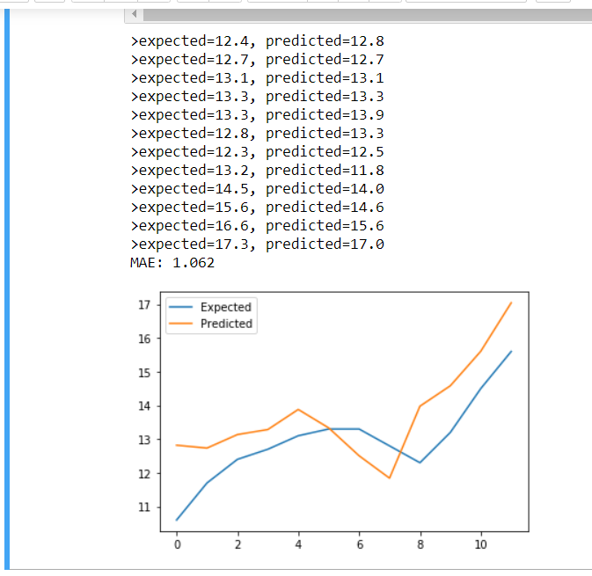
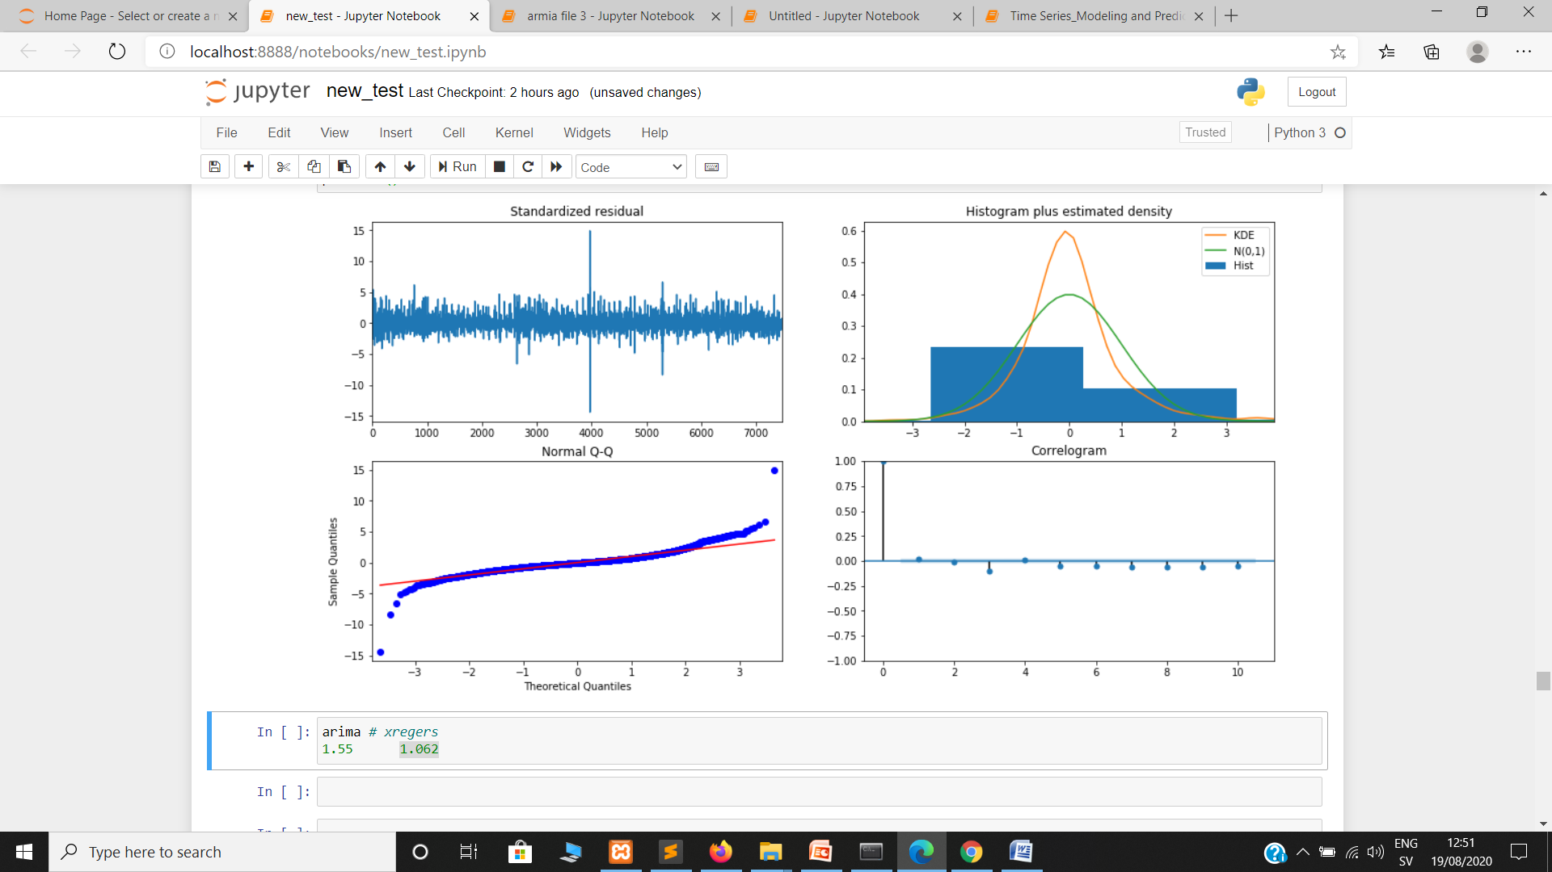
File 1
ARIMA Result
XGBRegressor Result
XGBRegressor (Mean Absolute Error) : 1.062 √
ARIMA (Mean Absolute Error) : 1.559

Slide 15
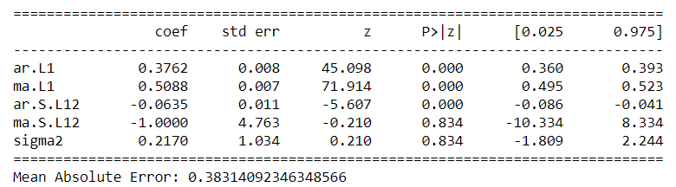
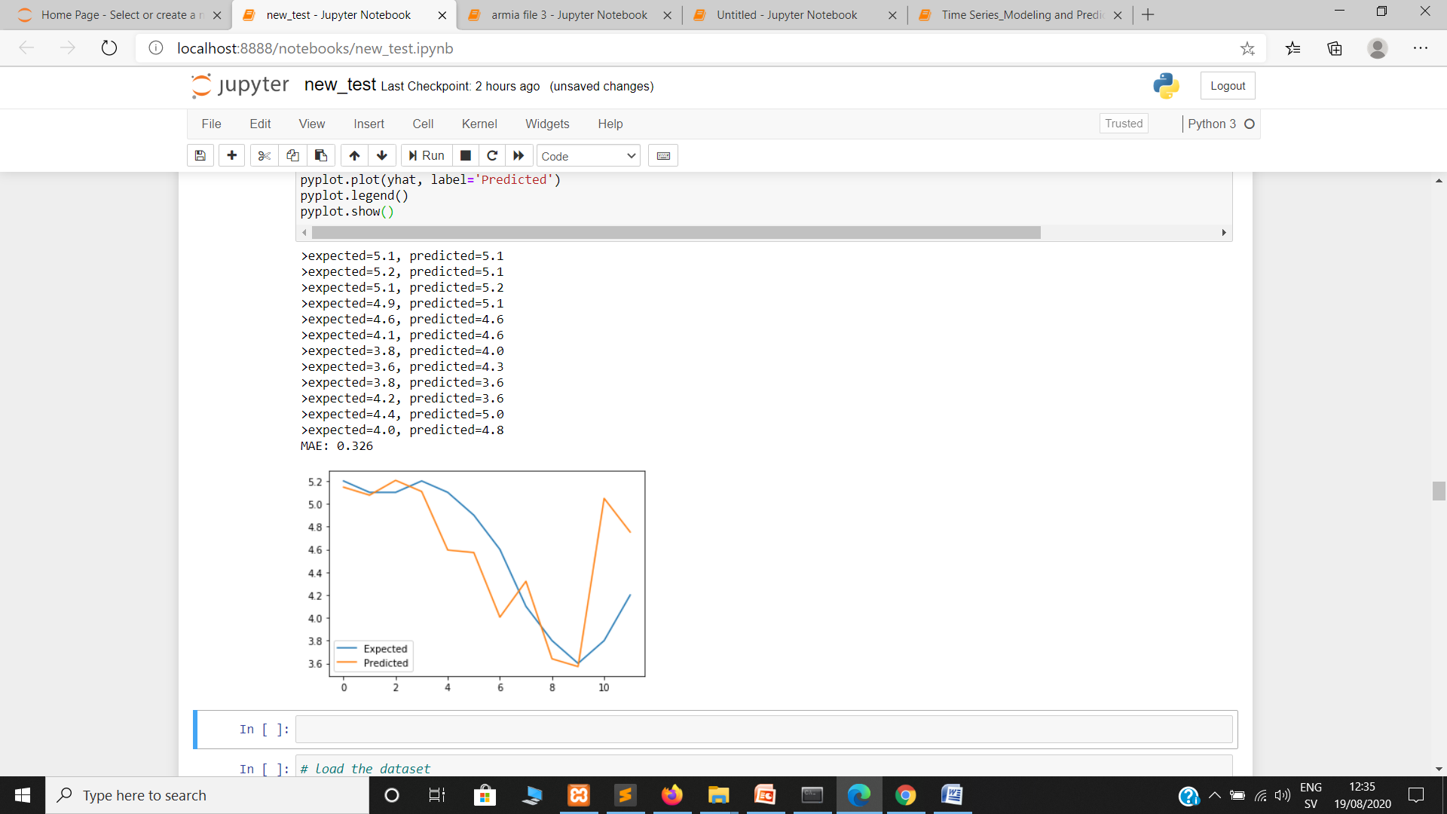

File 2
ARIMA Result
XGBRegressor Result
XGBRegressor (Mean Absolute Error) : 0.326 √
ARIMA (Mean Absolute Error) : 0.383

Slide 16
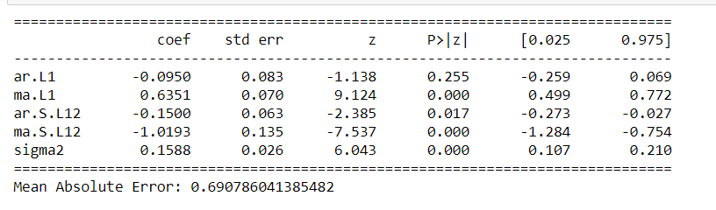
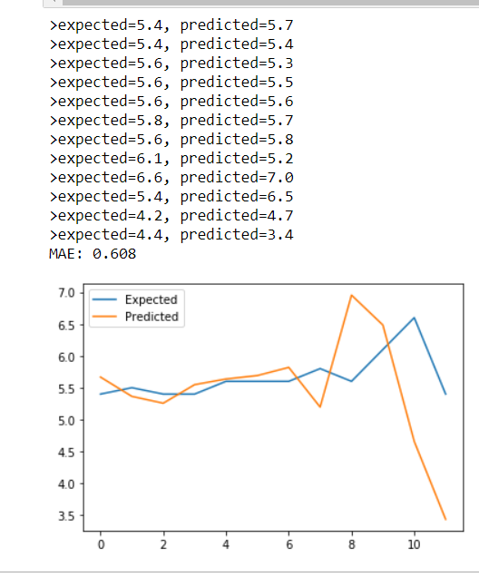
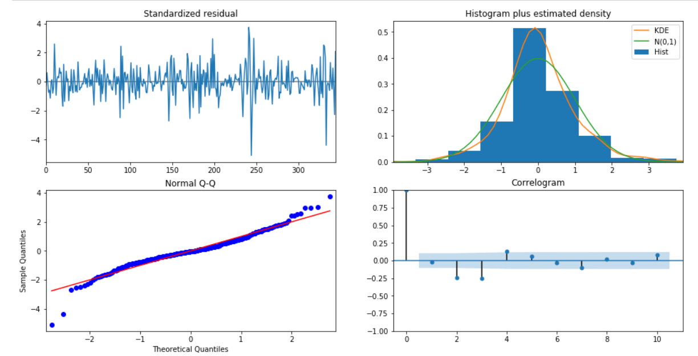
File 3
ARIMA Result
XGBRegressor Result
XGBRegressor (Mean Absolute Error) : 0.608 √
ARIMA (Mean Absolute Error) : 0.690

Slide 17
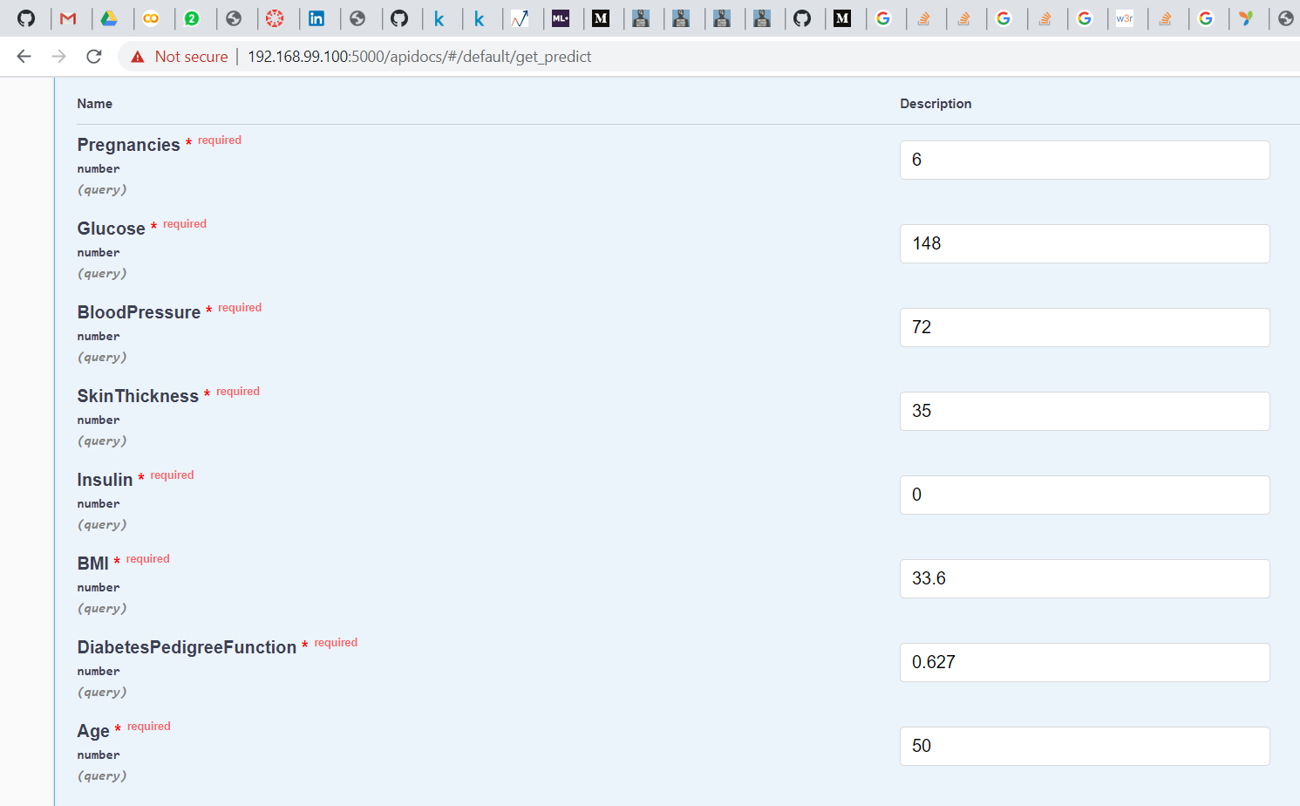
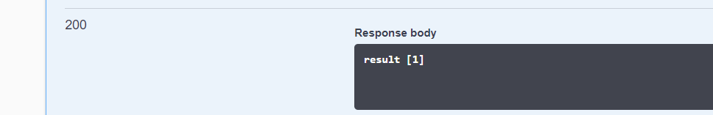
My Previous Project(Type 2)

Slide 18
Thank you for you attention

